Slide 1
Acute Pancreatitis
dr.amirreza salehi

Slide 2
question
The patient is a 35-year-old alcoholic who has epigastric pain that has spread to the back. He has fever, nausea and vomiting.
1. What is the differential diagnosis?
2. What are the paraclinical diagnostic measures?
3. List the necessary treatment measures based on the most probable diagnosis

Slide 3
Contents of Table
pancreas anatomy
Pancreatitis
Acute Pancreatitis
Patoghenesis
Etiology
Clinical Presentation
Severe pancreatitis
Lab test abnormality
Differential Diagnosis
Imaging
Treatment
Complications
Summary
Refrence

Slide 4
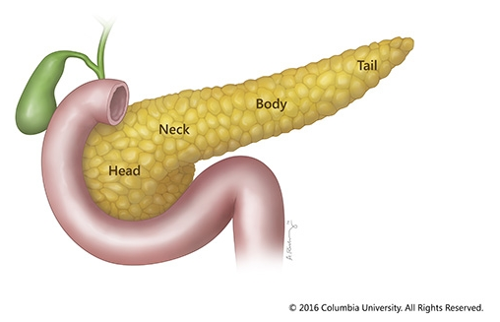
pancreas anatomy
The pancreas is a retroperitoneal gland that lies transversely just anterior to the second lumbar vertebra.
Normally, the pancreas is 12 to 18 cm in length and weighs between 70 and 110 g.
The gland is divided into four distinct parts: head,neck, body, and tail.

Slide 5
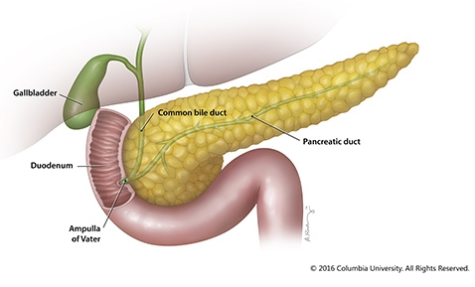
The duct of Wirsung typically forms a common channel with the common bile duct and enters the duodenum at the ampulla of Vater and the sphincter of Oddi (the major papilla).
The distal portion of the dorsal pancreatic duct may persist as the duct of Santorini (accessory pancreatic duct) or be totally obliterated.

Slide 6
Pancreatitis
Pancreatitis is inflammation of the pancreas that occurs when pancreatic enzyme secretions build up and begin to digest the organ itself.
It can occur as acute painful attacks lasting a matter of days, or it may be a chronic condition that progresses over a period of years.

Slide 7
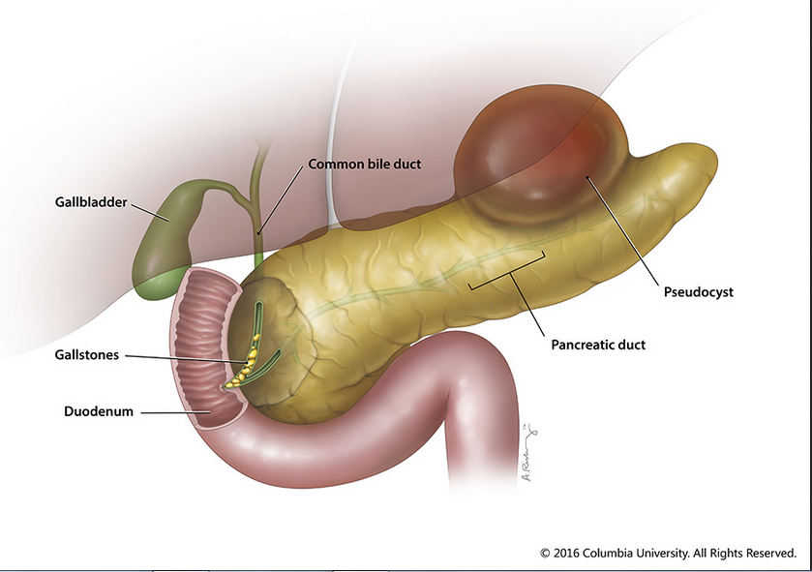
Acute Pancreatitis
Acute pancreatitis is a common disease that results from a malfunction in exocrine secretion.
self-limited to severe and life threatening.
It is associated with elevated pancreatic enzyme levels in the blood and/or urine.

Slide 8
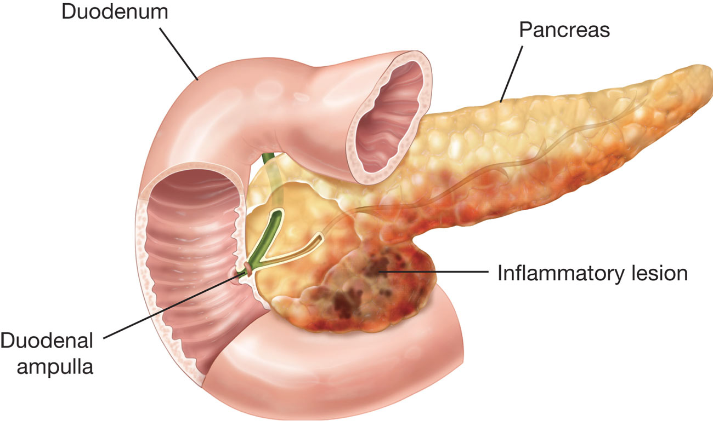
Patoghenesis
Acute pancreatitis is due to acinar cell injury, which allows activation of pancreatic enzymes outside of the pancreatic ducts and digestive tract.
This results in the destruction of pancreatic and peripancreatic tissue.
Grossly, the gland may be swollen, edematous, hemorrhagic, or even necrotic.
Histologic changes range from interstitial edema and infl ammation to hemorrhage and necrosis.

Slide 9
Etiology
Alcohol ingestion and biliary calculi account for 85%
Mechanical
postoperative
Traumatic
vascular
infectious,
Genetic
autoimmunes

Slide 10
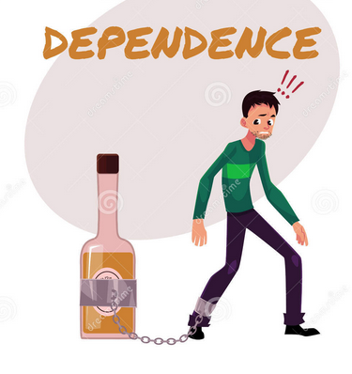
In patients with pancreatitis related to alcohol consumption, the fi rst episode is usually preceded by 6 to 8 years of heavy alcohol ingestion.

Slide 11
Mechanical causes of pancreatitis include anything that may obstruct the pancreatic duct.
This includes; gallstones,tumors, trauma, and parasitic diseases among others.
ERCP
Approximately 8% to 10% of cases of pancreatitis have no recognizable etiology (idiopathic pancreatitis), but the majority of these cases may be related to biliary tract sludge or microlithiasis.
Therefore, cholecystectomy is recommended in this group.

Slide 12
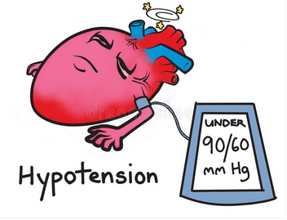
Ischemic injuries to the pancreas, secondary to hypotension
(e.g., during open heart procedures performed on pump)
or devascularization during upper abdominal surgery, may
also initiate pancreatitis or play a role in the progression of
pancreatic edema to pancreatic necrosis.

Slide 13
Mechanical causes of pancreatitis include anything that may obstruct the pancreatic duct.
This includes; gallstones,tumors, trauma, and parasitic diseases among others.
ERCP
Approximately 8% to 10% of cases of pancreatitis have no recognizable etiology (idiopathic pancreatitis), but the majority of these cases may be related to biliary tract sludge or microlithiasis.
Therefore, cholecystectomy is recommended in this group.

Slide 14
Clinical Presentation
non crampy, epigastric abdominal pain
Fever
upper abdominal
ileus
abdominal distention
nausea and vomiting
tachycardia

Slide 15
Clinical Presentation and Evaluation
Patients with acute pancreatitis have non crampy, epigastric abdominal pain.
The character of the pain is variable, and it frequently radiates to the left or right upper quadrant or the back.
The pain may be alleviated by sitting or standing.
It is associated with nausea and
vomiting.

Slide 16
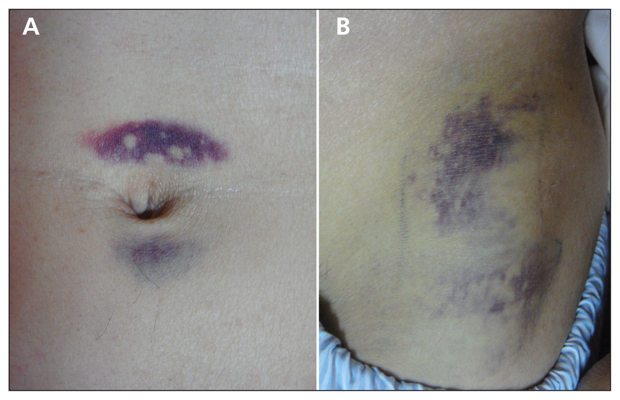
Severe pancreatitis
Generalized abdominal and rebound tenderness may also occur in severe pancreatitis.
In severe acute pancreatitis, blood may dissect into the posterior retroperitoneal soft tissue causing a flank hematoma known as Grey Turner’s sign(B) or up the falciform ligament resulting in a periumbilical ecchymosis called Cullen’s sign(A).

Slide 17
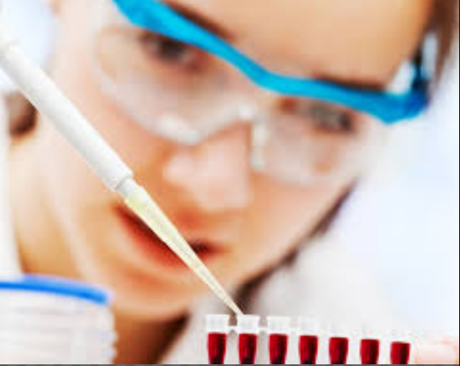
Lab test abnormality
Leukocytosis
An elevation of the serum amylase level 1.5 times the normal limit with a lipase value of 5 times the normal limit
. The serum amylase rises quickly within the first 12 hours after admission and usually returns to normal after 3 to 5 days.
In pationt with acute pancreatitis on the end stage chronic pancreatitis, may not be elevated in serum amylase even on admission.

Slide 18
Lab test abnormality
In severe cases of pancreatitis, there may be abnormal liver chemistries, hyperglycemia, hypocalcemia,
elevated blood urea nitrogen (BUN) and creatinine levels, and hypoxemia as a result of injury to the liver, lungs, and kidneys.

Slide 19
differential diagnosis
acute cholecystitis
perforated peptic ulcer
myocardial infarction
esophageal perforation
mesenteric
ischemia

Slide 20
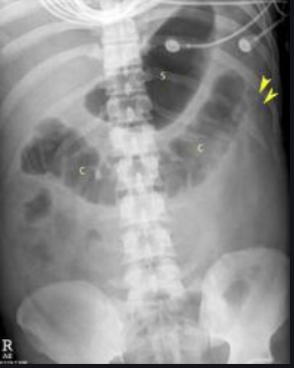
imaging
Patients with suspected acute pancreatitis should be evaluated radiographically with;
(1) a chest x-ray to look for sympathetic pleural effusions, atelectasis, or hemidiaphragm elevation (suggestive of fluid sequestration), and to exclude free air (pneumoperitoneum);

Slide 21
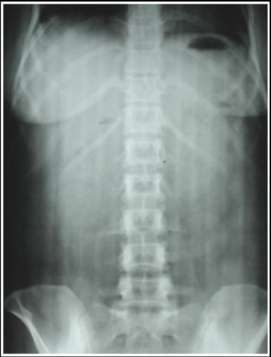
imaging
(2) plain and upright abdominal x-rays to evaluate for possible calcifications (indicating chronic pancreatitis), gallstones (though only about 15% of gallstones are radio opaque), local adynamic ileus (or signs of bowel obstruction), or a “cutoff sign” where gas in the transverse colon appears to end abruptly

Slide 22
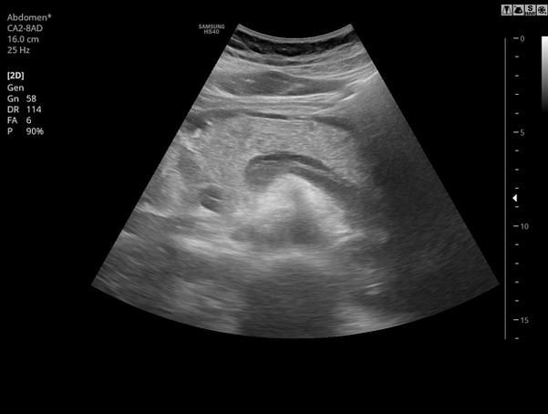
imaging
(3) ultrasonography to look for gallstones, common duct dilatation pancreatic enlargement, and per ipancreatic fluid collections.

Slide 23
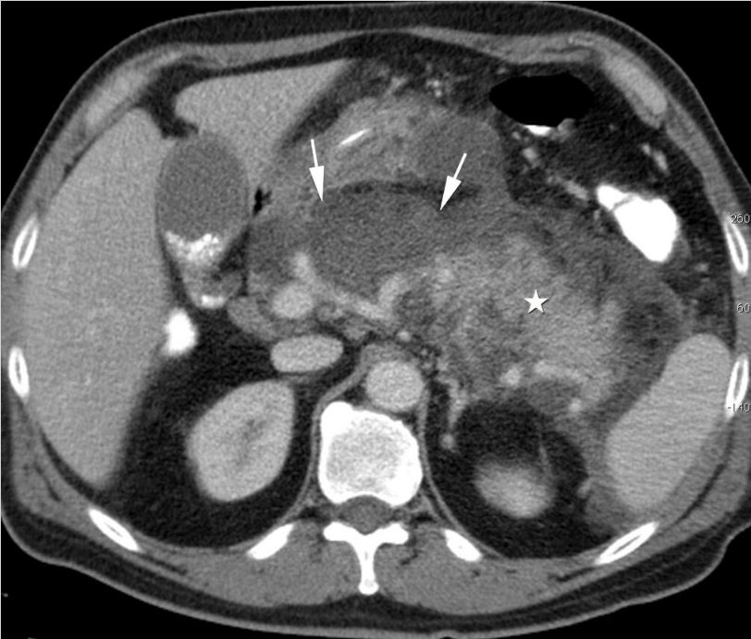
imaging
When the diagnosis is unclear=CT

Slide 24
Prognosis
Eighty percent of patients recover from the attack without sequelae.
twenty percent experience complications.
(Ranson’s criteria)
(APACHE II)
CT scans also yield prognostic information.

Slide 25
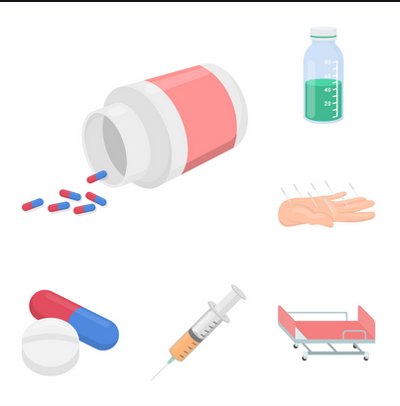
Treatment
In patients with mild bouts of pancreatitis, it is appropriate to withhold food until pain and tenderness resolve and the serum amylase and WBC return to normal.
Following more severe episodes of pancreatitis, it is important to maintain adequate tissue perfusion by monitoring cardiovascular parameters and maintaining adequate intravascular volume.

Slide 26
Treatment
Massive fluid sequestrations several liters of isotonic Electrolytes and blood glucose are carefully managed.
Respiratory function is monitored carefully, as sympathetic pleural effusions, atelectasis, adult respiratory distress syndrome due to SIRS, hemidiaphragm elevation, and fluid overload may impair oxygenation.

Slide 27
Treatment
Nasogastric suction has been theorized to decrease secretin release.
Practically, however, no obvious clinical benefit is seen in patients without significant nausea

Slide 28
Treatment
Antibiotics have also been used prophylactically in patients with pancreatitis to prevent infection of necrotic material, which is the number one predictor of survival.

Slide 29
Treatment
Nutritional support must also be provided t malnourished patients and to patients with severe disease who may not eat for a prolonged period.
Total parenteral nutrition may be required in patients without a functional gastrointestinal tract.

Slide 30
Treatment
In patients with severe gallstone pancreatitis, earl cholecystectomy should not be done due to the significant morbidity of this procedure in this population.
In patients with severe pancreatitis and a gallstone impacted at the ampulla of Vater, ERCP with sphincterotomy and stone extraction is advisable.

Slide 31
Complications
Infected Pancreatic Necrosis
Peripancreatic Fluid Collections and Pseudocysts
A pseudocyst is a collection of peripancreatic fluid contained in a cyst-like structure without an epithelial lining.

Slide 32
Complications
Pseudocysts may be communicating or noncommunicating, based upon whether the cyst is connected to the pancreatic duct. The wall of the nonresolving fluid collections thickens or matures over 4 to 6 weeks and forms a pseudocyst.

Slide 33
Summary
Acute pancreatitis is a relatively common disease that varies from a limited disease to a progressive and fatal disease.
The most common cause is gallstones and alcohol.
Treatment includes systemic disease control and pharmacotherapy.
There is a possibility of infectious and non-infectious complications.

Slide 34
Refrence
Peter f . Lawrence ;Essentials of general surgery ;fifth edition;2013p;344-367

